Slide 1


IOT Based Home Automation System
Submitted By: Chandan Kumar
Department: CSE
College: Ramgovind Institute Of Technology
Email id: Chandan.sranjan@gmail.com
Reg. Phone No. 7645843671
Submitted To : Emertxe Information & Technologies

Slide 2
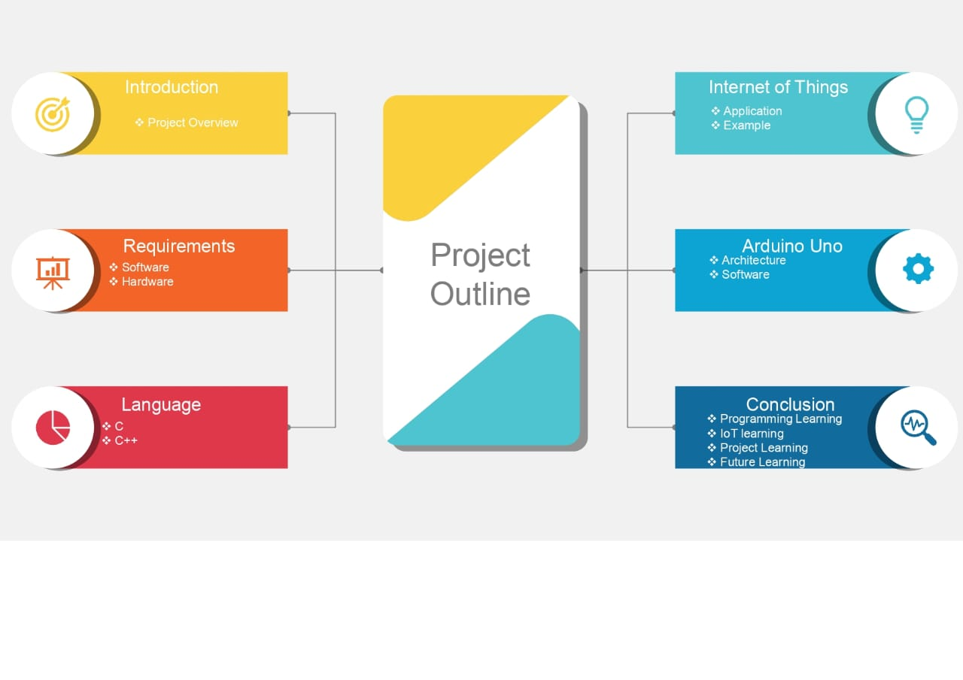

Slide 3
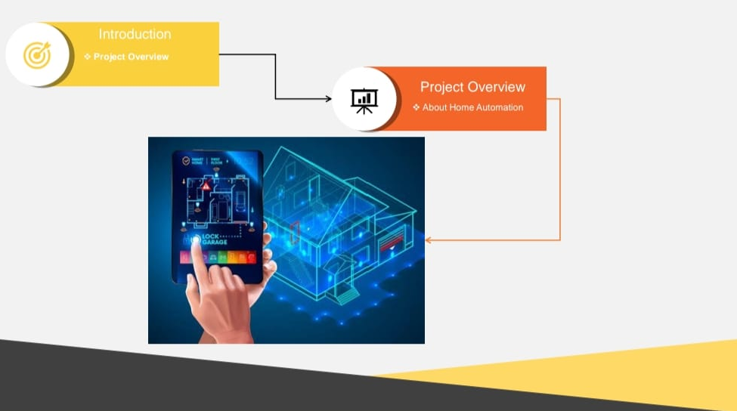

Slide 4
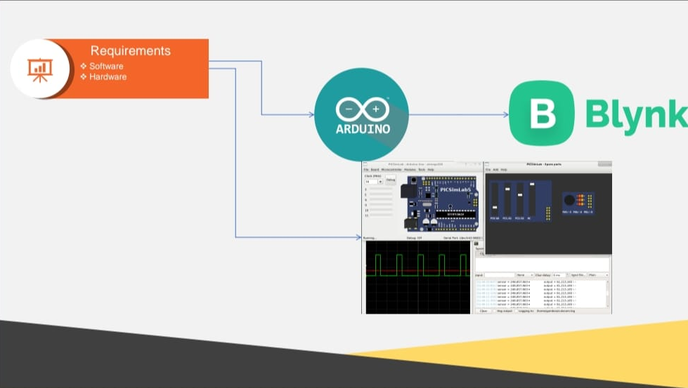

Slide 5
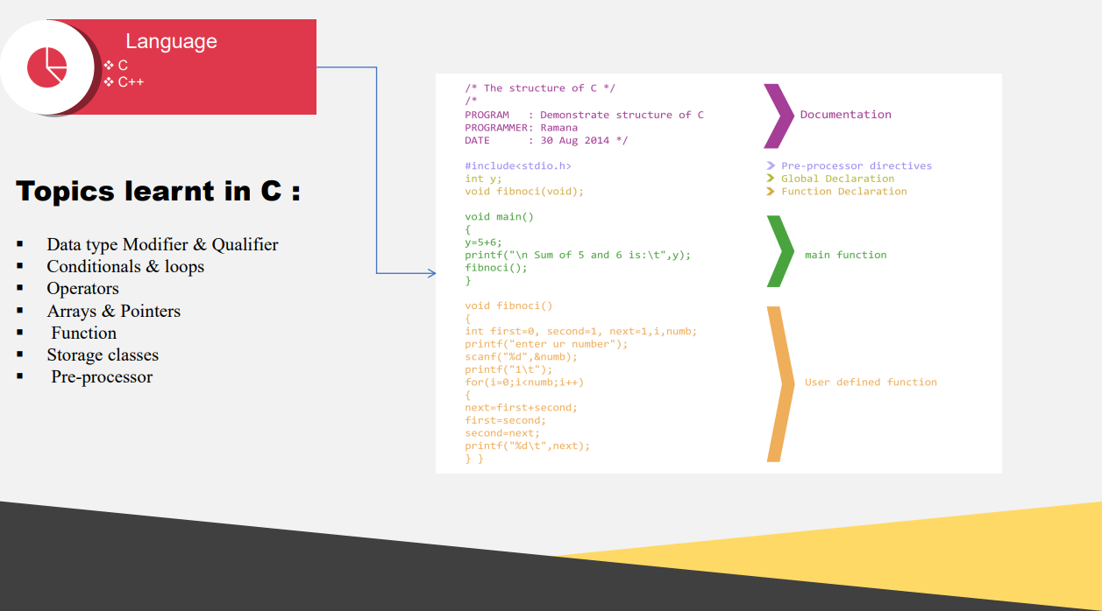

Slide 6
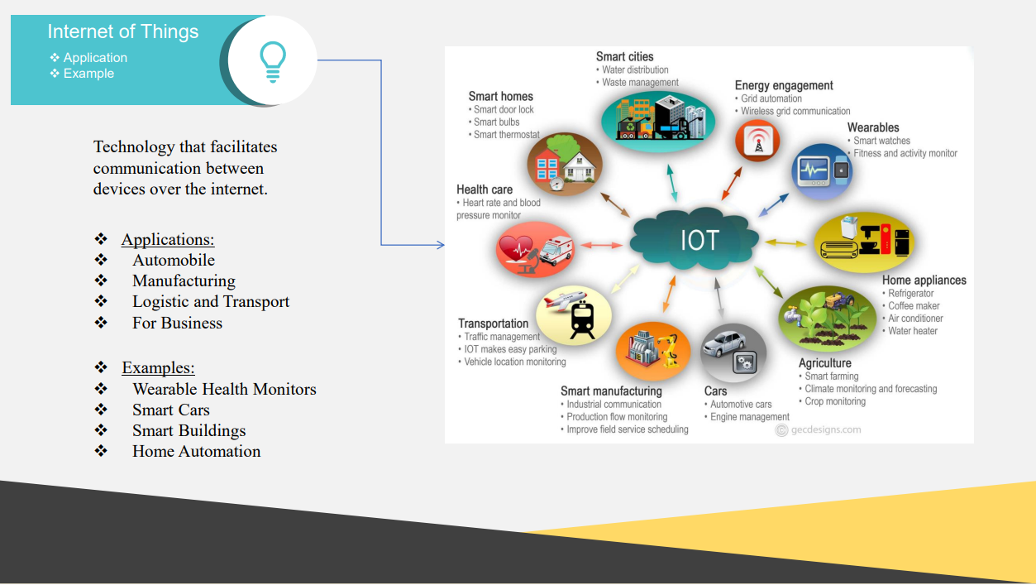

Slide 7
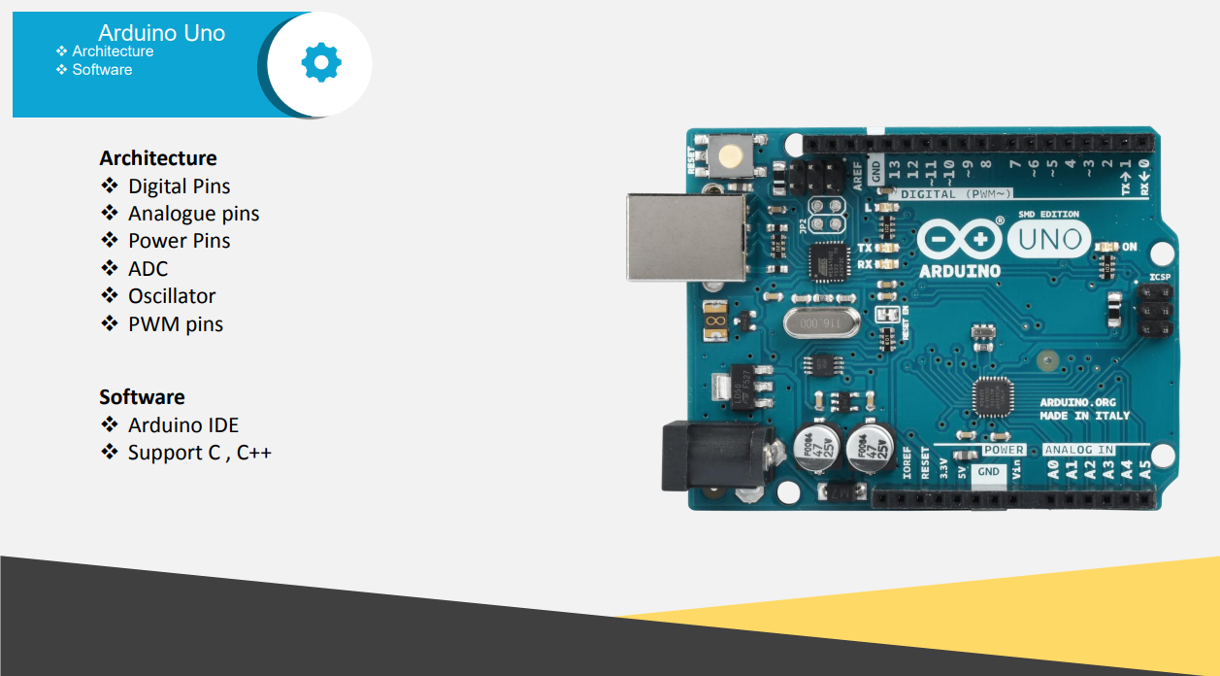

Slide 8
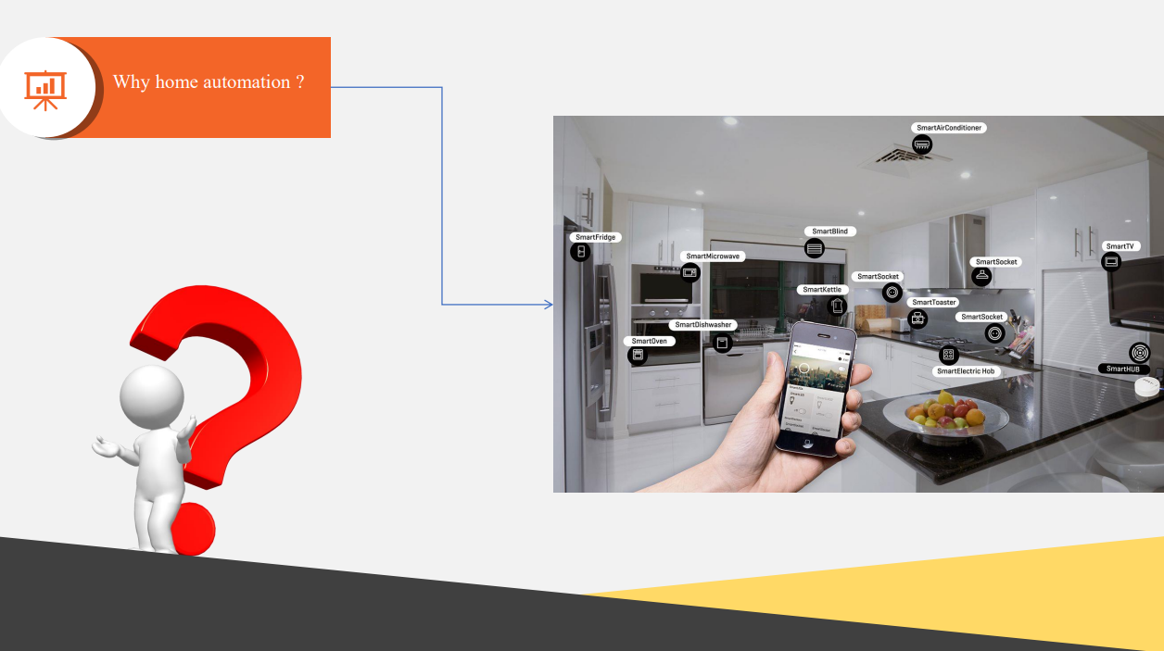

Slide 9
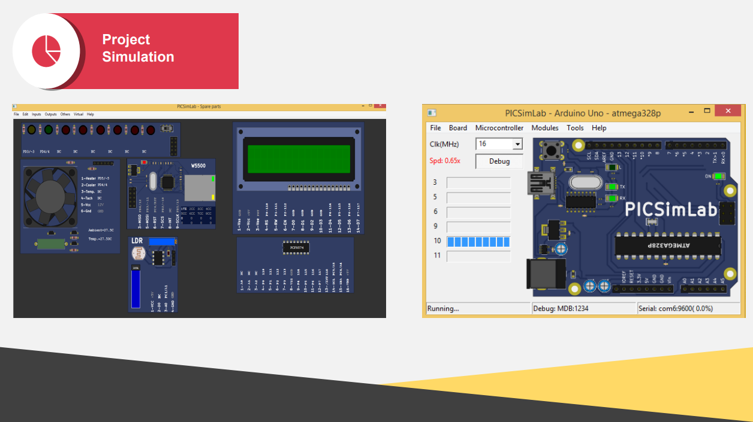

Slide 10


Slide 11


Slide 12
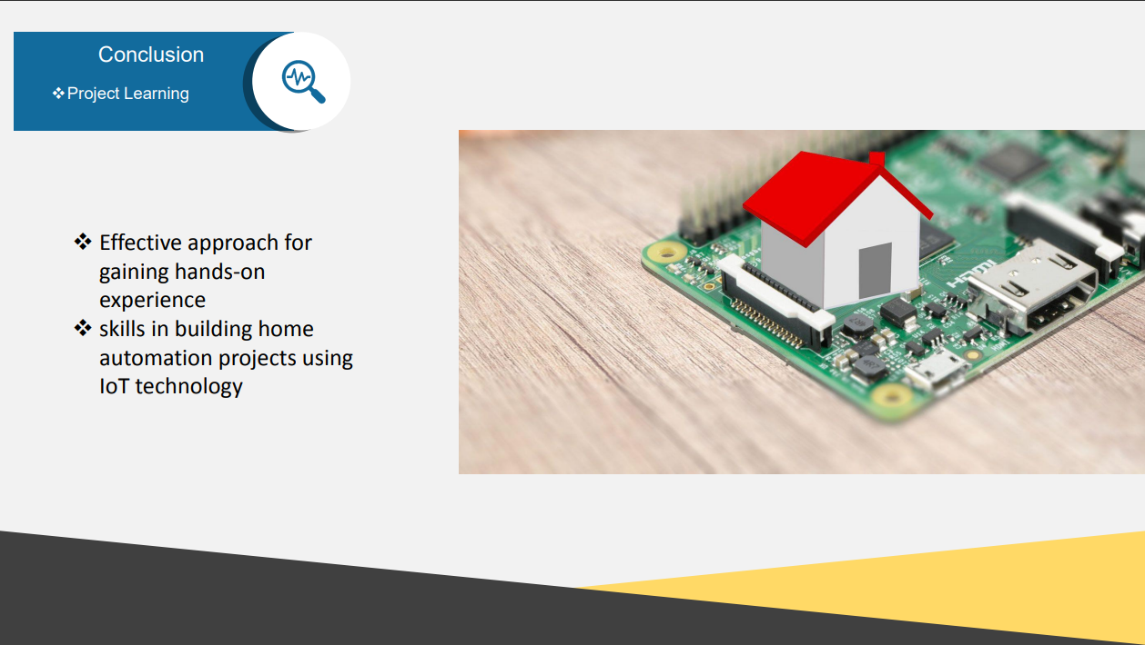

Slide 13
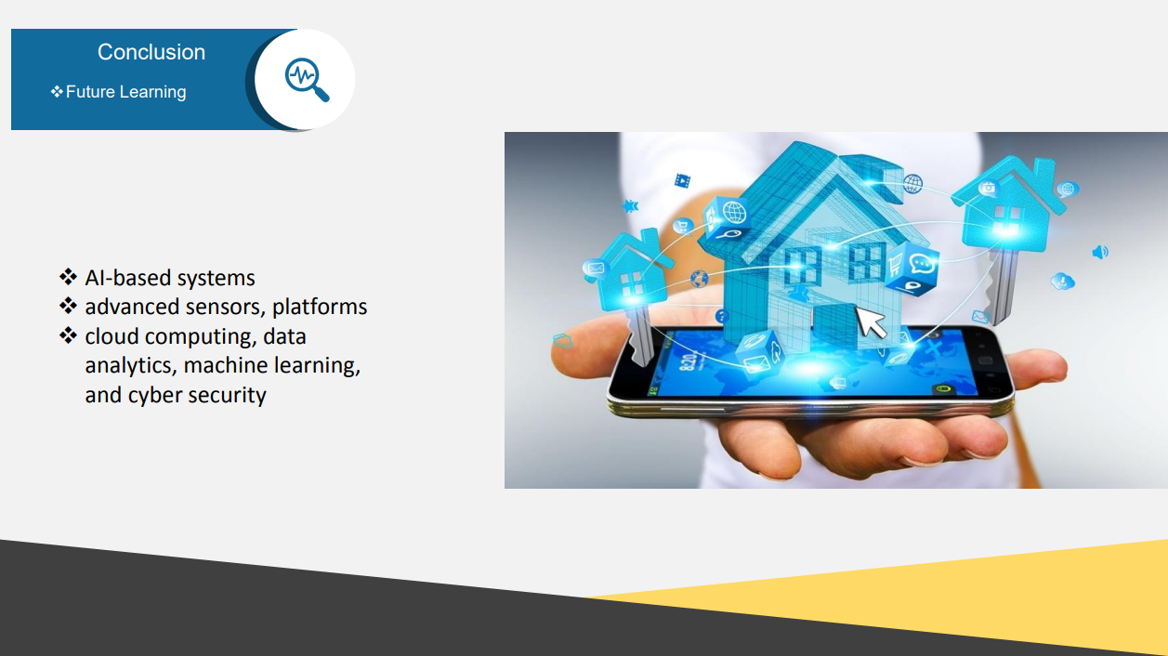

Slide 14


Follow me on Linkedin:
https://www.linkedin.com/in/chandan-kumar-a65457227

